Slide 1
10/19/22

Slide 2
QUIZ
ON
FRIDAY

Slide 3
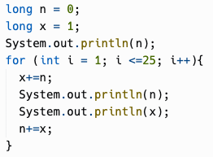
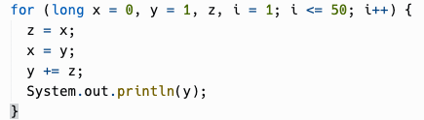
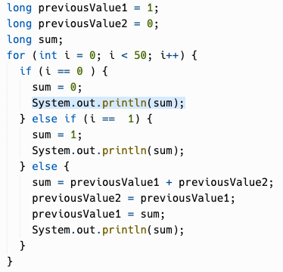
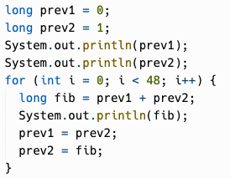
Notes:
Samples of student submissions for the Fibonacci repl. Some really interesting way of solving the problem, some I hadn't thought of before myself such as doing them two at a time.

Slide 4
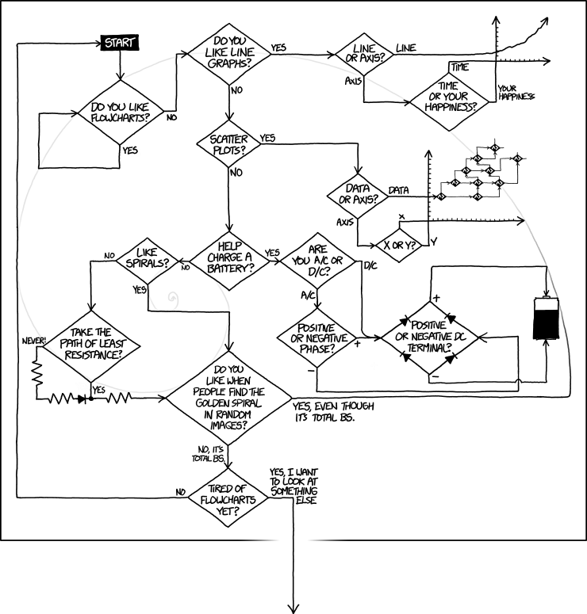
https://xkcd.com/1488/
Notes:
I showed a bunch of places where the Golden Spiral shows up on Monday. Another example is the arms of spiral galaxies. But it's almost become a meme that people see the golden spiral everywhere. You can even "find" it in this flowchart from popular webcomic xkcd.

Slide 5
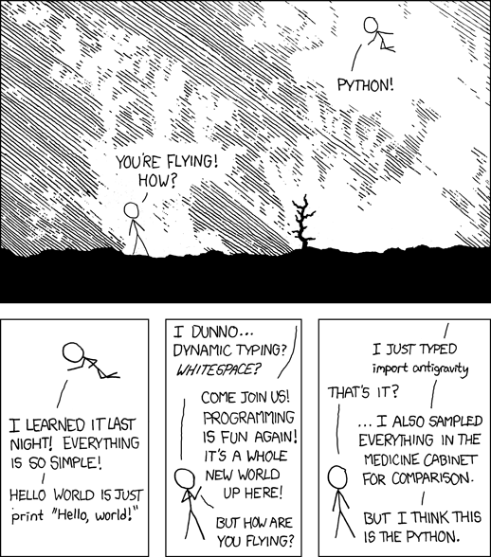
https://xkcd.com/353/
Notes:
Just another classic xkcd, that folks who took Mr. Haffner's class last year will be able to relate to.

Slide 6
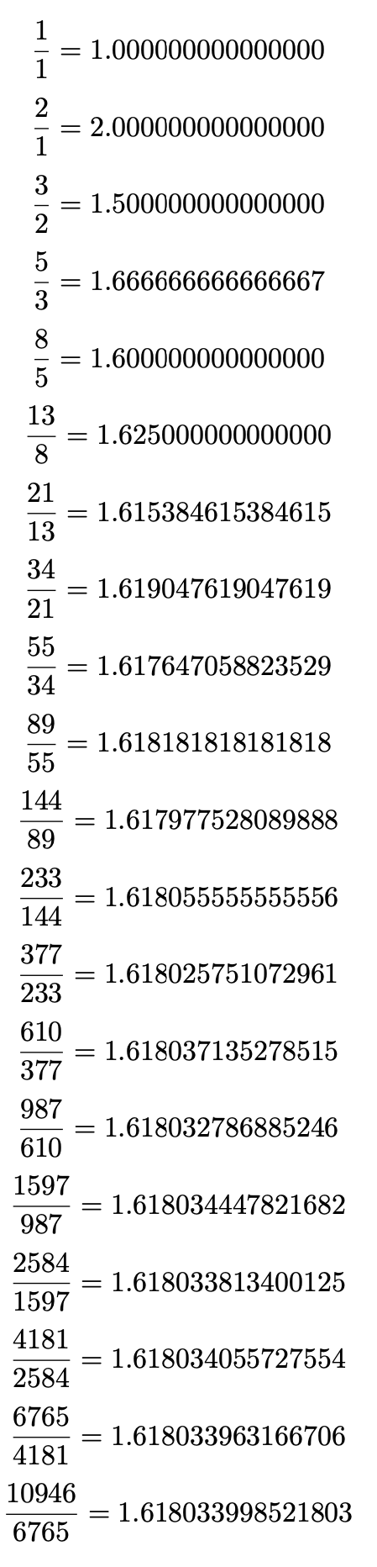
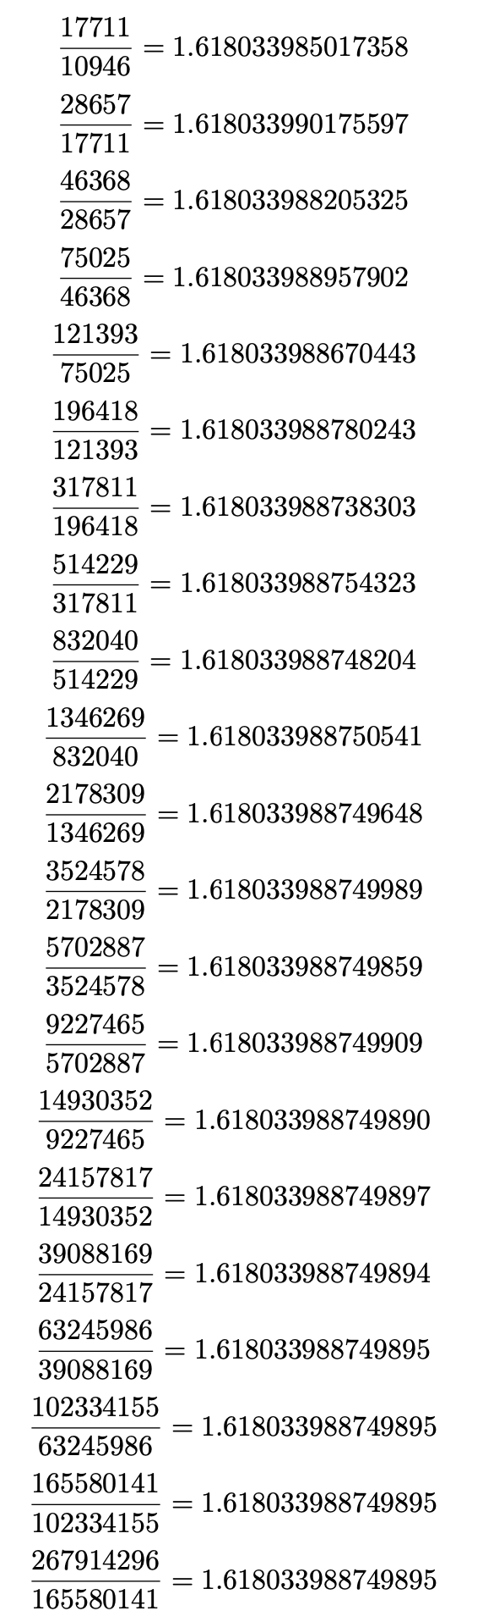
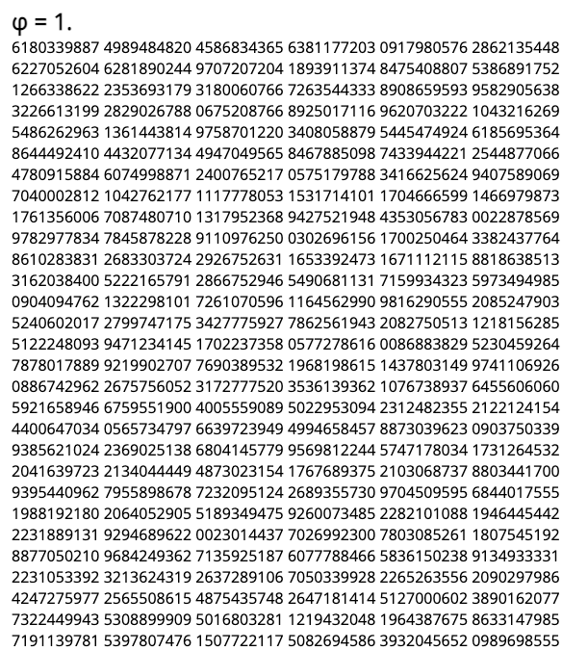
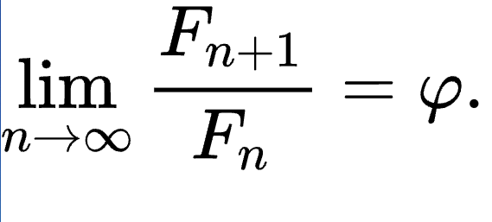
Notes:
The Golden Ratio is notated using the Greek letter phi (pronounced FEE not FIE). It is a transcendental number that goes on forever, so computers have to use approximations of it.
The Fibonacci Spiral aligns with the golden spiral (a logarithmic spiral with a growth rate of phi) because the ratio between a Fibonacci number and its predecessor in the sequence is approximately the golden ratio. For the first few numbers, you can see it's pretty off, but by the first 20 numbers, it's starting to get close to 1.618… As you go on to infinity, the ratio of those Fibonacci numbers converges to phi.

Slide 7
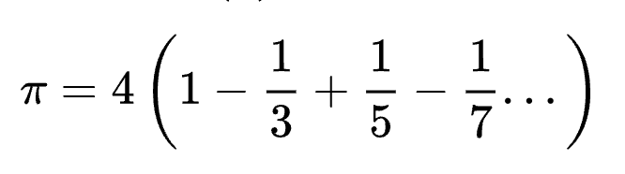
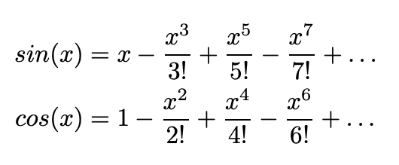
Series approximations
Deep down, computers are built out of circuits that do basic math operations like add, subtract, multiply, divide. To do a calculation like sin(x) or cos(x), computers use series approximations such as Taylor Series. There are series approximations that can be derived for many important mathematical formulas. Even pi itself has series approximations.
Notes:
WHY AM I TALKING ABOUT THIS? It gives you some insight into how computers do advanced math calculations. Down in their guts, computers really are built out of circuits that do basic math operations like add, subtract, multiply, divide. To do a calculation like sin(x) or cos(x), computers use series approximations such as Taylor Series. There are series approximations that can be derived for many important mathematical formulas. Even pi itself has series approximations.

Slide 8
Runtime Analysis
Chapter 4.5
Notes:
OK, now we get to the actual subject for today, runtime analysis

Slide 9
What makes a good algorithm?
From CodeHS:
What makes a good algorithm?
Correctness
Easy to understand by someone else
Efficiency (run time and memory requirements)
Correctness refers to whether the algorithm solves the given problem.
Easy to understand can be a function of the complexity of the algorithm design, as well as how the code is laid out, use of appropriate variable names, and the use of comments.
Efficiency can be looked at in several ways, which we will explore in this section.

Slide 10
Runtime analysis
How long an algorithm takes to execute (run) is called its running time or runtime.
Runtime analysis is the process of understanding how an algorithm or complete program will perform when it is run.
It includes how long the program takes to run, as well as other factors like how much memory is consumed.

Slide 11
Timing program execution
To understand how long a program takes to execute, can't we just… time it?
Every computer has multiple internal "clocks" that keep track of time (usually, the number of fractions of a second that have elapsed since a given base date).
In Java, people often measure the delta in System.currentTimeMillis() which returns the number of milliseconds since the "Unix Epoch" (January 1, 1970 00:00:00 in UTC time zone). This is wall clock time… if you adjust the date/time on your computer, the value will change.
System.nanoTime() is a newer method which returns nanoseconds since an arbitrary point in time. This timer is independent of the "wall clock" … it will continue increasing even if you futz with your computer's date and time.
Either may be acceptable, depending on your benchmark scenario.

Slide 12
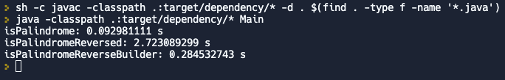
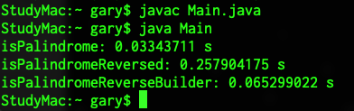
Why not just time things?
Different computers will give you different results, so timing benchmarks are only valid on the same hardware.
A lot of other stuff can be happening in other processes on a modern computer.
Different programming languages have different performance characteristics. (A fast algorithm in a "slow" language might be slower for some inputs than a slow algorithm in a "fast" language.)
Even the same programming language may behave differently in different environments.

Slide 13
Statement Execution Count
An alternative to timing a program segment is statement counting.
The number of times a given statement in a program gets executed is independent of the computer on which the program is run and is probably close for programs coded in closely related languages.

Slide 14
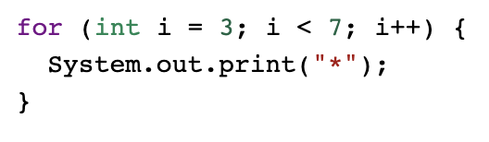
Statement Execution Count
Getting an absolute number of statements executed is tricky, and some of the things we may want to count are actually just expressions, not full statements.
Here, one way we might do it is to "point" it as follows:
int i = 3; counts as 1 point This part repeats for i=3, 4, 5, 6: i < 7 counts as 1 point System.out.print("*") counts as 1 point i++ counts as 1 point 1 + 3 * 4 = 13 "statements" total
There could be different counting methods here. On the AP exam, you'll probably be asked something more like: How many times is System.out.print called in this loop? That is, count how many times a specific statement is executed.

Slide 15


Loop Execution Count
You can use a trace table to figure out how many times a loop executes. But, you may be able to shortcut that just looking at it.
With a < condition, the number of iterations is (ending value - starting value) = 7 - 3 = 4 iterations.
When a <= is involved, the number of iterations is (ending value - starting value + 1) = 5 - 1 +1 = 5 iterations.
Both of these shortcuts assume the increment expression is just adding 1 to the counter.

Slide 16
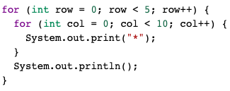
Loop Execution Count
For nested loops: The number of times a nested for loop body is executed is the number of times the outer loop runs multiplied by the number of times the inner loop runs (outer loop runs * inner loop runs).

Slide 17
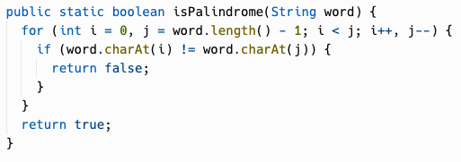
Best and worst case
Let's count the loop executions in this implementation of isPalindrome.
The loop execution count depends on the input.
The best case is that the first and last letters do not match, which would be a loop execution count of 0 (but a statement execution count of 3, for the init expression, condition check, and return statement.)
The worst case is… if the string is really a palindrome, and we have to check every pair of characters! That would be word.length() / 2 loop executions.
What about the average case?

Slide 18
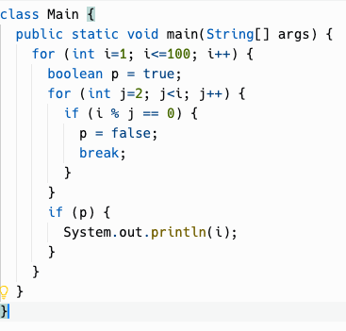
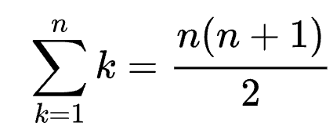
A more complicated nested loop
The outer loop executes 100 times. But the inner loop executes a different number of times for each i, and breaks out when it finds a number is not prime.
The inner loop executes at most once for i=3, twice for i=4, 3x for i=5, 4x for i=6. So the inner loop executes at most 3+4+5+6+...+98 times. We could calculate worst case time using this formula for 1+2+...+n and subtract 1+2:
But usually, we are not concerned with an exact count, but with getting a solid estimate. It's enough to determine what the loop execution time is proportional to.
Notes:
Still essentially a nested loop although one loop is in a method that is called
We'll trace through this loop in class

Slide 19
Running time is proportional to…
Let N=100. (We use capitals for this a lot, for some reason.)
The outer loop executes N times.
The inner loop executes a variable number of times, but it is bounded by N.
The loop execution count isn't exactly N^2… it's less. But it is proportional to N^2; it will grow in concert with N^2, even if it doesn't follow an exact linear relationship with it.
The running time of this loop is proportional to N^2.
An algorithm that runs in N^2 time is said to run in quadratic time.
Notes:
Still essentially a nested loop although one loop is in a method that is called
We'll trace through this loop in class

Slide 20
Running time is proportional to…
The concept of proportional to also removes our concerns about how fast a particular computer is, or how fast a particular programming language is.
We're analyzing the performance of the algorithm in the abstract world of mathematics, not in the concrete world of actual silicon.
Notes:
Still essentially a nested loop although one loop is in a method that is called
We'll trace through this loop in class

Slide 21
Linear time
What is our isPalindrome implementation proportional to?
The loop execution count depends on the input, but it is bounded by the length of the input. If the input is length N, the loop will not execute more than N/2 times.
We can ignore the N/2 factor since we're talking about proportionality.
So, isPalindrome running time is proportional to N, where N is the length of the string input.
An algorithm with running time proportional to N is said to run in linear time.
What about the average case?

Slide 22
Constant time
Some algorithms have a running time that isn't a function of its input parameters at all.
Such a function can be said to run in constant time.
The running time may not be exactly the same every time, like some exact drumbeat. But it is not a function of the input's length in any way.

Slide 23
Computational Complexity
In computer science, the computational complexity or simply complexity of an algorithm is the amount of resources required to run it.
Time complexity is the amount of time that an algorithm takes to run, but in an abstract sense of how many operations need to be executed, not a quantity of seconds or milliseconds. The usual units of time (seconds, minutes etc.) are not used because they are too dependent on the choice of a specific computer and on the evolution of technology.
Space complexity is how much memory an algorithm consumes. A lot of our algorithms so far allocate no memory, or allocate one or two things. This is constant space complexity. Constant space complexity means that the amount of space that your algorithm uses is independent of the input parameters. Linear space complexity means you probably allocated an array of size N, or for, quadratic, N^2, etc.

Slide 24
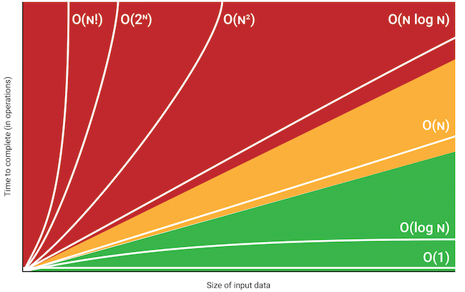
Big O notation
Big O notation is a common way of stating the upper bound of an algorithm's time or space complexity.
You might calculate that an algorithm takes at most 5N^2+8N+4 operations.
As N gets very large, the N^2 dominates everything else, and we take out the constant factor, so we say the algorithm is O(N^2).

Slide 25
Big O notation
The time complexity and space complexity of algorithms are often expressed using "Big O notation"
O(1) = Constant time
O(N) = Linear time
O(N^2) = Quadratic time
You can think of it as, the algorithm's upper bound (maximum) running time or memory usage is proportional to 1, N, N^2, etc.
There are other common ones, such as O(N^3), O(log N), O(N log N). We'll be seeing algorithms with some of these time and space complexities later in the course.
(There is also Big Omega and Big Theta notation but our brains are full enough for one day.)

Slide 26
"Real" time and space
When we talk about time complexity and space complexity, we eliminate constant factors so that advances in computer hardware, speed of programming languages isn't a factor.
In practice, real time taken by an algorithm does matter, as well as how much memory it consumes, too.
If you make an algorithm run 2X faster in wall clock time, you've saved your company money, or made your scientific computation give an answer sooner, etc.
Same if you reduce your program's memory use from 1000 bytes per record to 500 bytes per record.

Slide 27
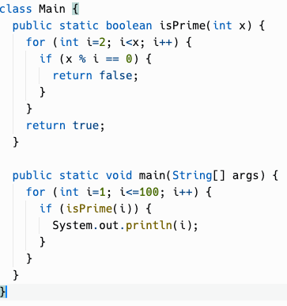
Finding Prime Numbers
Remember our prime number finder from last session, and the assertion that a 2000-year old algorithm can do it more efficiently.
How much more efficiently?
Notes:
Still essentially a nested loop although one loop is in a method that is called
The number of loop iterations that happens is the same; the program will take the same amount of time (with a little bit added for the method call overhead)
Is this algorithm efficient? The running time is proportional to N^2, where N is the highest number you're checking to be prime.
N^2 grows very quickly. It's fine for small values of N but can grow to the point where algorithms can take years to finish.

Slide 28
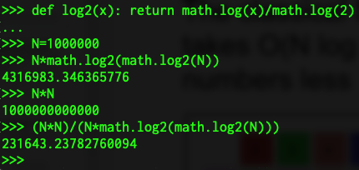
Sieve of Eratosthenes vs. My Naive Prime Finder
The classical Sieve of Eratosthenes algorithm takes O(N log (log N)) time to find all prime numbers less than N.
My naive approach using "trial division" takes O(N^2) running time.
Suppose N = 1,000,000. Using Python as a calculator… log₂x = ln x / ln 2
Assuming the same constant factor, the naive approach takes ~230,000 times longer to run!
Notes:
Still essentially a nested loop although one loop is in a method that is called
We'll trace through this loop in class
The Sieve of Eratosthenes is quite simple, and we may come back and implement it later, but you really need arrays to do it.
Start with knowing 1 is prime. 2 is prime.
2 is prime, so any multiple of 2 is NOT prime… you can mark them all off, up to the limit, as not being prime.
Then the next unmarked number is prime, so, 3 is prime.
Now mark all off multiples of 3 as being NOT prime…
4 will be already marked as not prime, so then 5… and so on.
This sculpture is called the Sieve of Eratosthenes. It's in the sculpture garden on the campus of Stanford University. I suppose it looks like an actual sieve.

Slide 29
Practice!

Slide 30


Slide 31
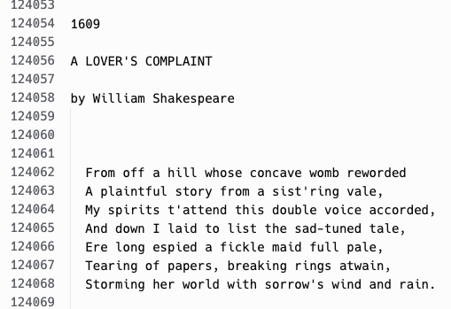

Shakespeare: State Machine
START
WAIT_FOR_YEAR
Year seen
WAIT_FOR_TITLE
Title seen
WAIT_FOR_END
THE END seen

Slide 32
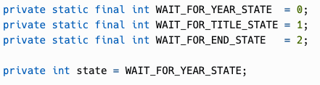
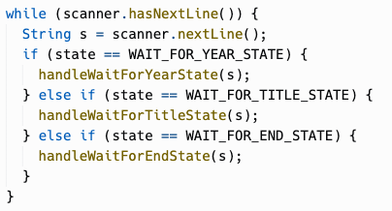
Shakespeare: State Machine
START
WAIT_FOR_YEAR
Year seen
WAIT_FOR_TITLE
Title seen
WAIT_FOR_END
THE END seen

